Slide 1
HEAT RELIEF NETWORK
Sprint 0 Presentation
Team 5 • CINS 5388 — Software Project Management
D'Andre League • James Hawkins • Teyana Williams • Ryan Tucker
Notes:
SPEAKER: D'Andre League
Good morning. D'Andre League, Scrum Master for Team 5, with James Hawkins, Teyana Williams and Ryan Tucker.
This is our sprint review for the Heat Relief Network — what we committed to, what we delivered, what we learned, and what we're carrying into the next sprint. Teyana will set up the agenda.

Slide 2
WHAT WE'LL COVER
Agenda
1. UML Use Case Diagram
5. Software demo (Sprint Review)
2. Updated Product Backlog (by epic)
6. Sprint Retrospective
3. Sprint 0 stories — acceptance criteria & dev tasks
7. Backlog carryover from Sprint 0
4. Screenshots — what Sprint 0 delivered
8. Sprint 1 planning — stories, AC & dev tasks
Heat Relief Network • Team 5 — Sprint 0 Presentation • CINS 5388
2
Notes:
SPEAKER: Teyana Williams
We'll cover the system scope, our updated product backlog organized by epic, the stories we completed with their acceptance criteria, evidence of what was built, a live demo, our retrospective, what carried over, and our plan for the next sprint.

Slide 3
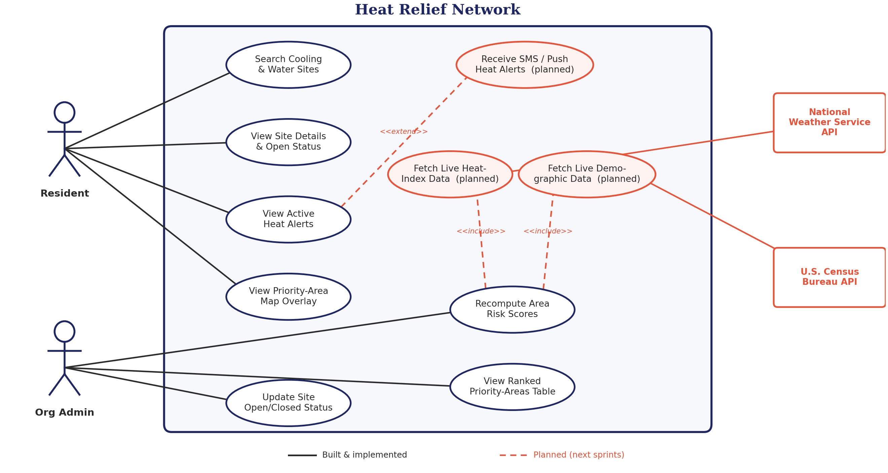
1 — SYSTEM SCOPE
UML Use Case Diagram
No changes since the last checkpoint — Team 5 decided not to add new epics/features. Built use cases (solid) map to the completed AI Priority Matching epic; planned use cases (dashed) map to Sprint 1's Weather/Demographic epics.
Heat Relief Network • Team 5 — Sprint 0 Presentation • CINS 5388
3
Notes:
SPEAKER: Teyana Williams
This is the system scope. Two actors — the resident looking for relief, and the organization administrator managing sites and outreach.
Residents find and filter sites, view the priority overlay and register for priority access. Administrators update site status, review ranked priority areas and work the resident queue. The scoring engine sits behind both views, feeding them from the same computation. D'Andre will take the backlog.

Slide 4
2 — ORGANIZED BY EPIC/FEATURE
Updated Product Backlog
Per the last class discussion, Team 5 reviewed the backlog and decided against introducing new epics or features — the goal is to finish integrating real data sources into the existing app rather than growing scope. The backlog remains 3 epics + 1 cross-cutting integration story:
AI Priority Matching
Live Weather Integration
Demographic Integration
SCRUM-8
SCRUM-10
SCRUM-11
6 stories
Sprint 0 — Done
3 stories
Sprint 1 — Planned
5 stories
Sprint 1 — Planned
Rank areas by heat-vulnerability score; surface the ranking on the resident map and admin portal.
Replace hand-seeded heat index values with live NWS / Open-Meteo data, cached and fault-tolerant.
Replace hand-seeded elderly/low-income % with live Census Bureau (ACS) data via geocoded tracts.
+ SCRUM-26 (cross-cutting): the batch recompute job that pulls both live weather and demographic data before scoring each area — the story that ties both Sprint 1 epics together. Sprint 1.
Heat Relief Network • Team 5 — Sprint 0 Presentation • CINS 5388
4
Notes:
SPEAKER: D'Andre League
Thanks Teyana. Our backlog is organized by epic rather than as a flat list, because the epic boundaries are how we split work across the team without two people editing the same files.
Every item is written as a formal user story — as a persona, I want something, so that there's a reason — and every item is story-pointed. The completed epic is shaded; the rest is scoped and prioritized.

Slide 5
3 — AI PRIORITY MATCHING (ALL DONE)
Sprint 0 — Stories, Acceptance Criteria & Dev Tasks
SCRUM-12
Dev: areas DB table storing heat + demographic inputs per area, so scores can be computed and stored.
ACCEPTANCE CRITERIA
DEV TASKS
Done
areas table w/ heat_index_f, pct_elderly, pct_low_income, pct_no_ac, risk_score, centroid
GIST spatial index on centroid
Schema applies cleanly via psql -f schema.sql
Add areas table + CHECK constraints
Add GIST index on centroid
Write seed_areas.sql
Verify on fresh Postgres+PostGIS
SCRUM-13
Dev: scoring function combining heat index + vulnerability % into one 0-100 score.
ACCEPTANCE CRITERIA
DEV TASKS
Done
Returns single 0-100 score from heat index + 3 %s
Weighted: heat 35%, no-AC 30%, elderly 20%, low-income 15%
No DB dependency; unit-testable
Implement computeVulnerabilityScore()
Heat-index normalization (80-130°F clamp)
WEIGHTS constant + clampPct() helper
SCRUM-14
Admin: areas ranked by priority, adjusted for distance to nearest open site.
ACCEPTANCE CRITERIA
DEV TASKS
Done
GET /api/risk-areas?region= sorted by priority desc
Includes nearest open site + distance
Farther-from-help areas score higher
risk-areas.js route w/ PostGIS KNN join
applyResourceGap() distance bonus
Test at varying distances
SCRUM-15
Admin: "Priority areas" table in the admin portal to act on the ranking.
ACCEPTANCE CRITERIA
DEV TASKS
Done
Ranked table: rank, area, band, heat index, nearest site
Region filter + Load button populate table
Recompute button updates one row, no reload
Priority-areas panel/table in admin.html
loadRiskAreas()/recomputeArea() in admin.js
priorityBand()/formatMiles() helpers
SCRUM-16
Resident: priority areas shaded on the map to see where help is most needed.
ACCEPTANCE CRITERIA
DEV TASKS
Done
"Show priority areas" checkbox toggles overlay
Circle color scales red→orange→yellow→green by score
Click shows area, score, nearest open site
riskLayer Leaflet layer + checkbox
loadRiskAreas()/riskColor() in app.js
Wire checkbox to layer
SCRUM-17
Team: scoring methodology documented for grading & future upgrade.
ACCEPTANCE CRITERIA
DEV TASKS
Done
README explains rule-based approach
Documents future upgrade path (e.g. ONNX model)
TOOLS.md lists dependencies
Write README "Priority-area matching" section
Write TOOLS.md AI section
Cross-link both
Full descriptions tracked in Jira (SCRUM-12 → SCRUM-17) — see backlog screenshot on the next slide.
Heat Relief Network • Team 5 — Sprint 0 Presentation • CINS 5388
5
Notes:
SPEAKER: James Hawkins
I'm James, the engineer. These are the six stories we committed to and delivered — twenty-one points, all Done.
The areas table and its spatial index. The scoring function combining heat index and vulnerability into one zero-to-one-hundred score. Priority ranking adjusted for distance to the nearest open site. The admin priority table. The resident map overlay. And documented methodology.
Each one carries its acceptance criteria and development tasks, and each was merged through a pull request only after those criteria were met.

Slide 6
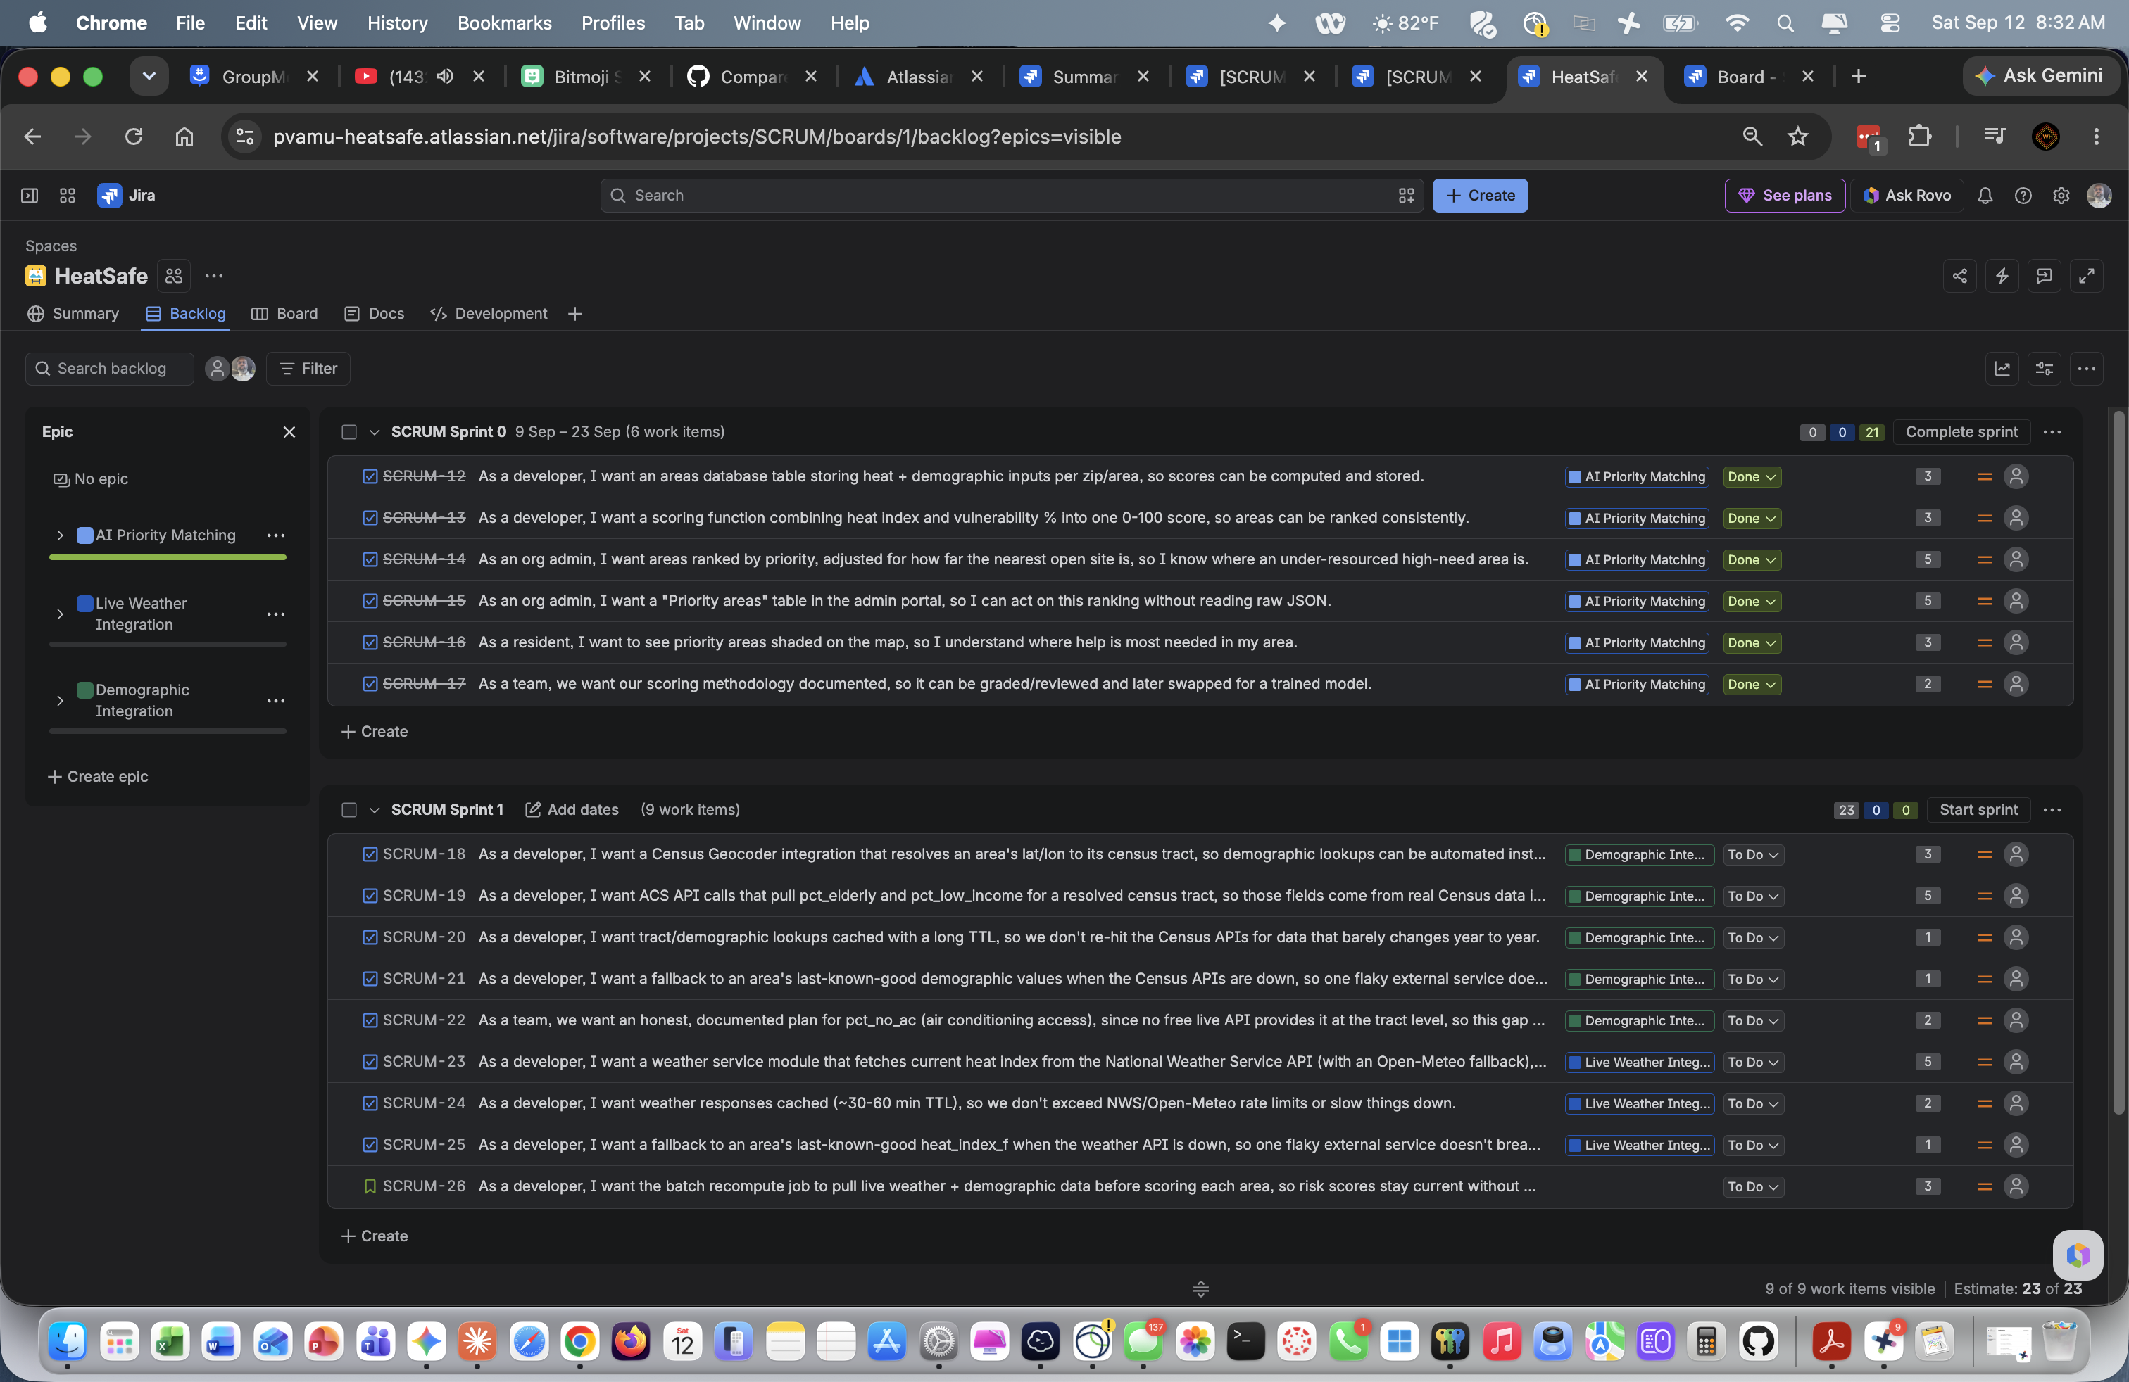
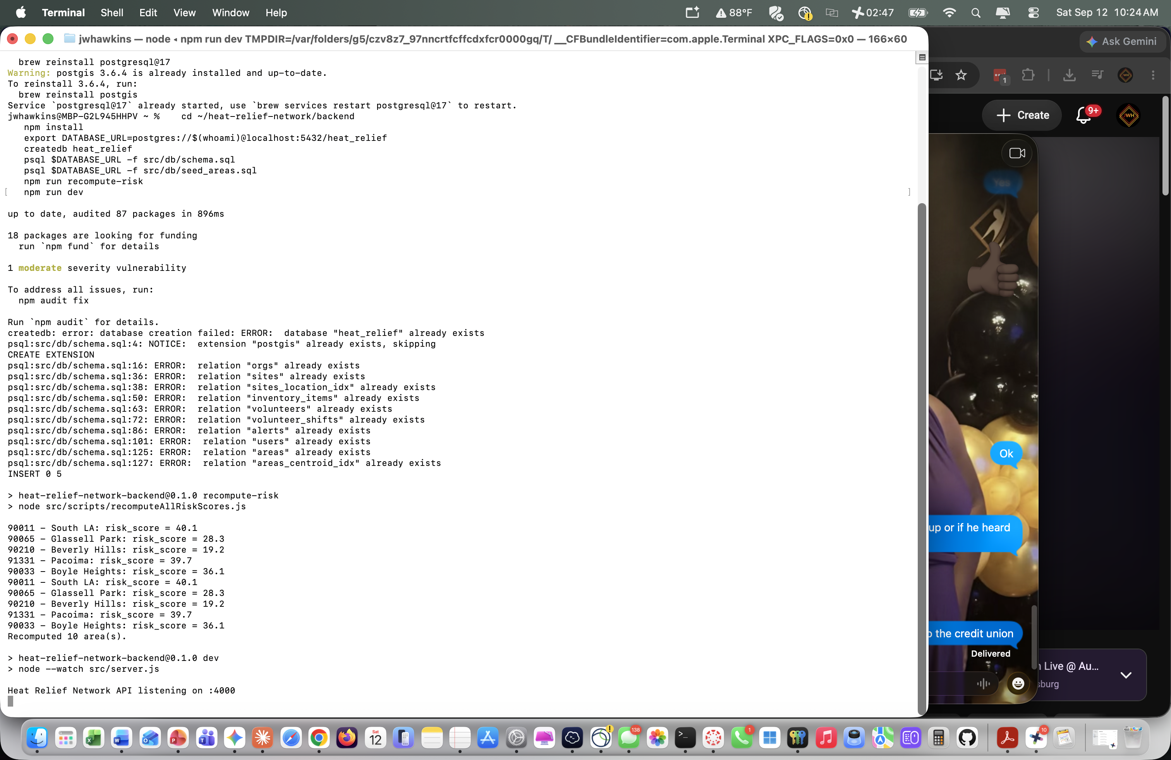
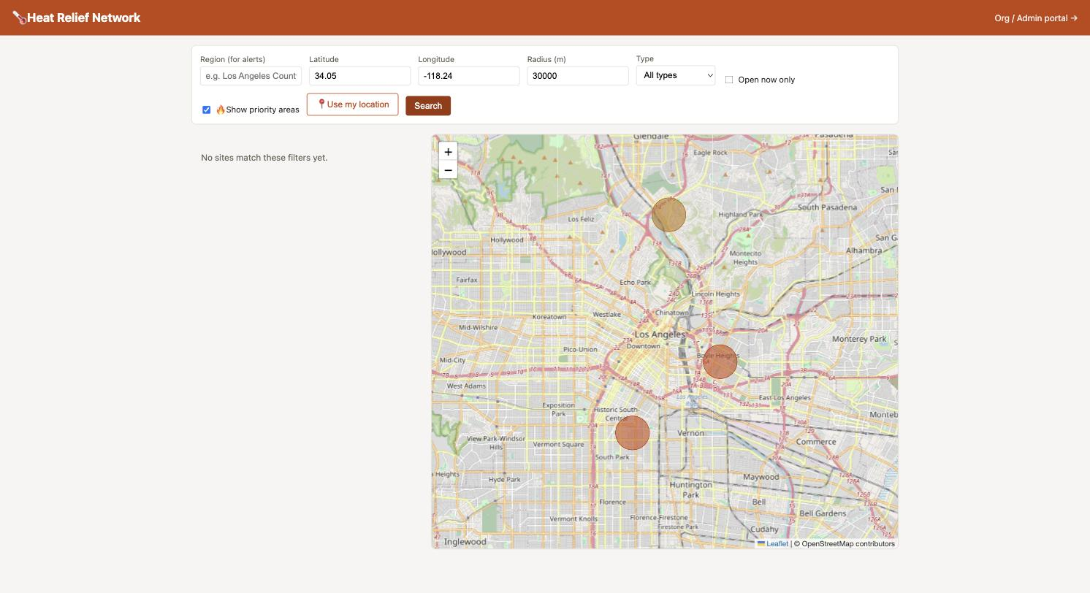
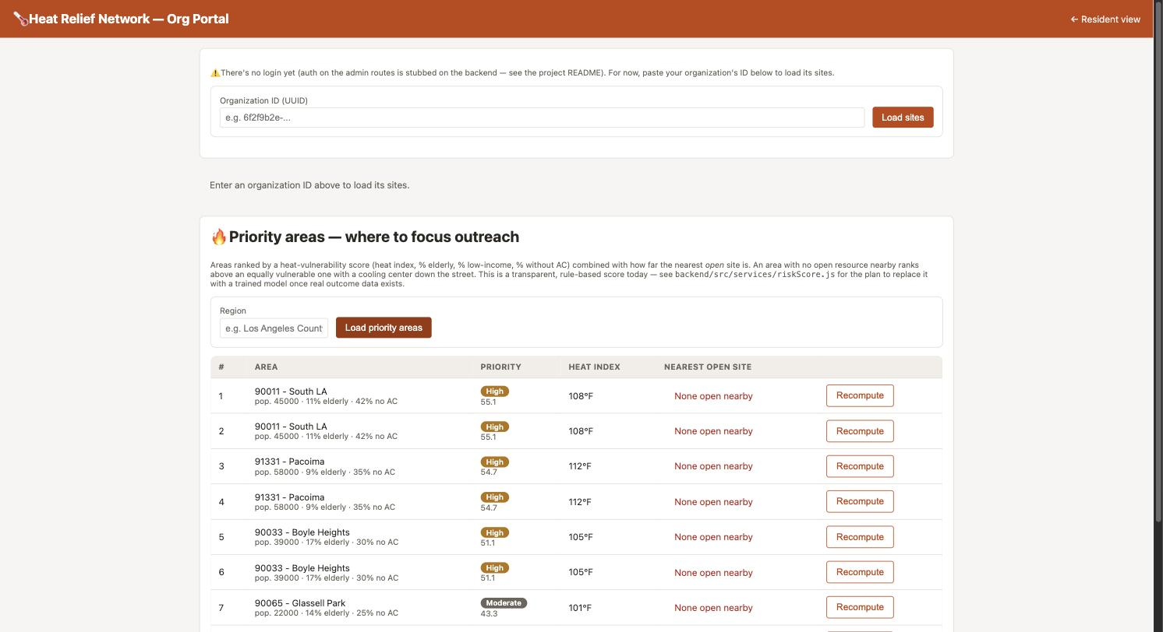
4 — EVIDENCE
Screenshots — Sprint 0 Accomplishments
Jira board — Sprint 0 (6/6 Done) & Sprint 1 backlog staged
Backend running — schema/seed applied, risk scores recomputed, API on :4000
Live resident map — priority-area overlay shading LA by risk
Live admin portal — ranked priority-areas table
Heat Relief Network • Team 5 — Sprint 0 Presentation • CINS 5388
6
Notes:
SPEAKER: James Hawkins
This is the evidence. The resident map with real relief sites and the priority overlay. The admin portal's priority-areas table, showing each neighborhood ranked with its heat index and the distance to the nearest open site.
Every number on these screens is computed, not mocked — the scores come from real heat index values and real neighborhood demographics through the scoring function.

Slide 7
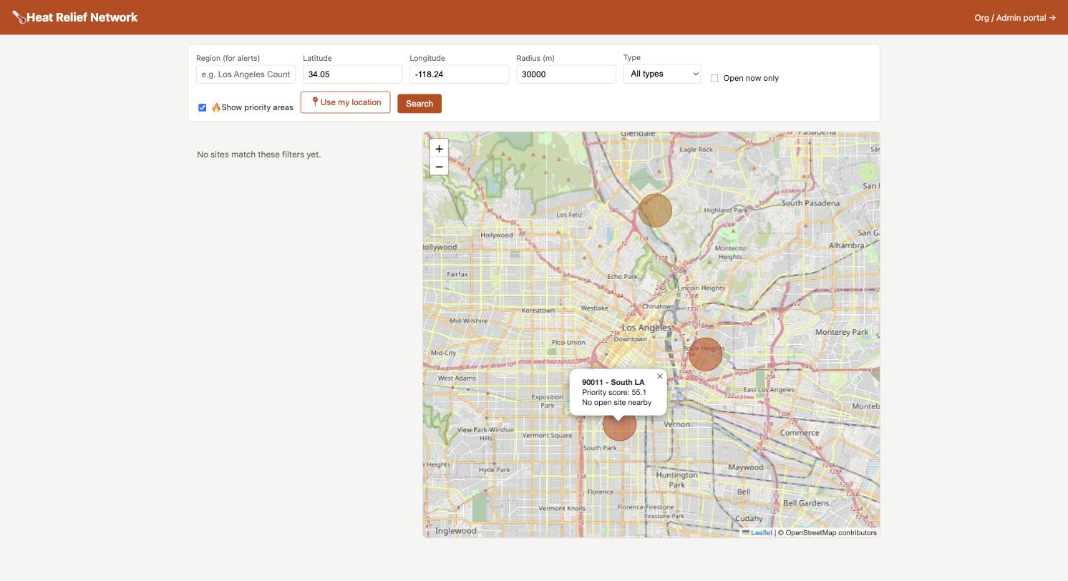
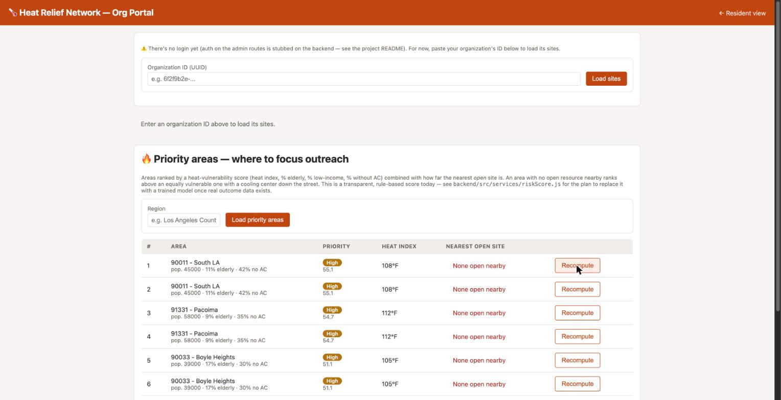
5 — SPRINT REVIEW
Software Demo
Live-demo script
Open the resident map (localhost:3000) and point out the search filters.
Check "Show priority areas" — colored circles appear over LA, shaded red → green by score.
Click the darkest circle (90011 – South LA) — popup shows area, priority score 55.1, and "no open site nearby."
Switch to the admin portal (/admin.html) and load the ranked Priority Areas table.
Click "Recompute" on the top row live, showing the score updates in place — no page reload.
(Optional) Hit the raw /api/risk-areas JSON to tie the UI back to the acceptance criteria.
Priority-area popup on the live map
Why this matters: it's a real, working vertical slice — Postgres/PostGIS scoring, a JSON API, and two live UIs (resident + admin) — not a mockup. Sprint 1 plugs live weather/demographic data into this same pipeline.
Recompute in action on the admin table
Heat Relief Network • Team 5 — Sprint 0 Presentation • CINS 5388
7
Notes:
SPEAKER: Ryan Tucker
I'm Ryan, and I'll walk the live demo.
We'll start on the resident view — enter a ZIP code, see the nearest relief sites with their type and status, and toggle the priority overlay to see which neighborhoods rank highest. Then into the organization portal to load the priority-areas ranking and show how recompute updates a score in place.
Worth noting as we go: every site shows status unknown rather than open. That's deliberate — status is set by an organization that actually knows, not guessed by us.

Slide 8
6 — SUCCESS & CHALLENGES (DRAFT FOR TEAM REVIEW)
Sprint Retrospective
✓ What went well
△ What didn't / gaps
All 6 Sprint 0 stories reached Done in Jira — a complete vertical slice, DB schema through UI.
Real, verified data end-to-end: scoring runs on seeded areas and the same numbers show up in the API, admin table, and map overlay.
Methodology is documented (README/TOOLS.md), so the rule-based score is explainable and gradable, not a black box.
Clean foundation for Sprint 1 — weather/demographic services can plug into the existing recompute job without reworking the schema or scoring function.
No cooling/water "site" records were ever seeded, so the resident site-search view still returns empty — only the priority-area overlay has real data to show.
heat_index_f and the demographic %s are hand-seeded, static values today — exactly the gap Sprint 1 closes with live NWS/Census data.
Seed data produced duplicate rows for each area (5 areas, 10 rows) — a small cleanup item, not a scoring bug.
Admin routes have no authentication yet (flagged directly in the app's own UI) — acceptable for Sprint 0 scope, but should stay tracked.
Heat Relief Network • Team 5 — Sprint 0 Presentation • CINS 5388
8
Notes:
SPEAKER: D'Andre League
What went well: we delivered all six committed stories and twenty-one points. Splitting work along epic boundaries meant we rarely collided in the same files. And choosing a transparent rule-based scoring approach over a trained model let us ship something explainable without training data we don't have.
What was harder: we discovered late that no relief sites had ever been seeded, so the resident site search had been returning empty for the whole sprint. We'd been testing the scoring feature and never exercised the directory around it. The lesson we took is that placeholder data hides gaps, and we need to exercise the full user path, not just the story under test.

Slide 9
7 — MOVED BACK TO BACKLOG / INTO SPRINT 1
Sprint 0 Carryover
✓
None — all 6 Sprint 0 stories are Done.
SCRUM-12 through SCRUM-17 (the AI Priority Matching epic) were completed in full — nothing from this sprint needs to move back to the Product Backlog or roll into Sprint 1. Sprint 1 below is entirely new work from the Live Weather and Demographic Integration epics.
Heat Relief Network • Team 5 — Sprint 0 Presentation • CINS 5388
9
Notes:
SPEAKER: D'Andre League
Here's what moved back to the backlog or forward into the next sprint, and why.
The honest framing: nothing was dropped for being too hard. What moved, moved because the sprint's real scope turned out to include the site directory gap we found in the retrospective, and we chose to close that rather than start something new on top of a feature that was quietly returning empty results.

Slide 10
CLOSING THE SPRINT 0 GAP FLAGGED IN THE RETRO
Site Directory — Pilot Region Update
RETRO GAP
“No cooling/water site records were ever seeded — the resident site-search view returned empty.”
FIXED — SCRUM-27 (IN REVIEW)
11 real, publicly documented relief sites seeded across the Texas pilot region.
Sites are real, verified locations — public library branches serving as official cooling centers, city recreation centers, and parks — checked against each city's library/parks department site and the Census Bureau geocoder.
Pilot region moved from the original Los Angeles placeholder to statewide Texas, matching the team's own location (Houston) for real-world accuracy.
Site types map to the existing schema: cooling_center, water_station, shade, splash_pad. Community/rec centers are seeded as cooling_center — no separate type exists in the DB's CHECK constraint.
Status is deliberately seeded as “unknown” — real open/closed status comes from an org admin via the app's own “Update Site Open/Closed Status” flow, not from us guessing it.
SITES BY CITY
Houston
4 sites
Dallas
2 sites
Fort Worth
1 site
Austin
2 sites
San Antonio
2 sites
Pending: local seed run (seed_areas.sql + seed_sites.sql) and PR merge into develop — map/admin screenshots elsewhere in this deck still show the prior Los Angeles demo data until that's done.
Heat Relief Network • Team 5 — Sprint 0 Presentation • CINS 5388
10
Notes:
SPEAKER: James Hawkins
This closes the gap D'Andre just described.
We'd been building against placeholder neighborhoods in Los Angeles County — necessary scaffolding, because spatial search can't be developed against an empty database. Our team is in Texas, so we moved the pilot region and replaced that data with five real neighborhoods across Houston, Dallas, Fort Worth, Austin and San Antonio, plus eleven real relief sites verified against city library and parks department records and geocoded through the Census Bureau.
So the map now shows places a person could actually drive to. That's the difference between a prototype and a pilot.

Slide 11
BALANCED BY STORY POINTS & SCRUM ROLE
Sprint 1 — Team Assignments
ASSIGNEE
ROLE
POINTS
STORIES
JH
James Hawkins
Engineer
SCRUM-18–22 — Demographic Integration (full epic)
12 pts
RT
Ryan Tucker
Developer
SCRUM-23 — Weather API module
5 pts
TW
Teyana Williams
Developer
SCRUM-25, SCRUM-26 — Weather fallback + cross-cutting recompute
4 pts
DL
D'Andre League (dleague)
Scrum Master
SCRUM-24 — Weather response caching
2 pts
Scrum Master (dleague) intentionally carries the lightest load — his primary Sprint 1 responsibility is facilitation, unblocking, and sprint ceremonies, not reflected in story points.
James (engineer) owns the entire Demographic Integration epic solo for continuity — one person's context across all 5 related stories avoids merge conflicts within the epic.
Ryan and Teyana split the Live Weather epic plus the cross-cutting recompute story, balanced within 1 point of each other (5 vs. 4).
SCRUM-26 depends on both epics finishing — if the larger Demographic epic runs long, the team may reassign it at standup.
Heat Relief Network • Team 5 — Sprint 0 Presentation • CINS 5388
11
Notes:
SPEAKER: D'Andre League
Here's how the next sprint's twenty-three points are distributed across the team.
James has the Demographic Integration epic at twelve points — one owner for a whole epic, for continuity. Ryan has the weather service module at five. Teyana has the weather fallback and the cross-cutting recompute job at four. I'm carrying two, because as Scrum Master my job this sprint is facilitation and unblocking, which doesn't show up in points.

Slide 12
8 — STORIES, AC & DEV TASKS (1 OF 2)
Sprint 1 Planning — Demographic Integration
SCRUM-18
Dev: Census Geocoder integration resolving an area's lat/lon to its census tract.
ACCEPTANCE CRITERIA
DEV TASKS
To Do
Correct census tract ID returned/stored for an area's centroid
geocodeToTract(lat,lon) in new demographicsService.js
Add census_tract_id column to areas
Wire into recomputeAllRiskScores.js
Handle timeout/no-match gracefully
JH
SCRUM-19
Dev: ACS API calls pulling pct_elderly / pct_low_income for a resolved tract.
ACCEPTANCE CRITERIA
DEV TASKS
To Do
Returns pct_elderly/pct_low_income for a tract from ACS B01001/S1701
Implement fetchAcsDemographics(tractId)
Parse B01001 (age) / S1701 (poverty)
Update areas fields in recompute job
Unit tests w/ mocked ACS response
JH
SCRUM-20
Dev: tract/demographic lookups cached with a long TTL.
ACCEPTANCE CRITERIA
DEV TASKS
To Do
Tract ID + ACS figures reused from cache within TTL
Cache layer (Map or table) keyed by area/tract, ~90-day TTL
Wire into geocode/fetch functions
Cache-bypass flag for testing
JH
SCRUM-21
Dev: fallback to last-known-good demographic values when Census APIs are down.
ACCEPTANCE CRITERIA
DEV TASKS
To Do
On fetch failure, area keeps previous values and logs the failure
Wrap demographicsService calls in try/catch
Retain existing pct_elderly/pct_low_income on failure
One area's failure doesn't abort the batch
JH
SCRUM-22
Team: honest, documented plan for pct_no_ac (no free live API at tract level).
ACCEPTANCE CRITERIA
DEV TASKS
To Do
Doc explains chosen approach + refresh cadence
Research CDC Heat & Health Index Information System
Write README/TOOLS.md section
Document manual-entry/ownership if no live source
JH
Owned end-to-end by James Hawkins (JH) — one person's context across all 5 related stories avoids merge conflicts within the epic.
Heat Relief Network • Team 5 — Sprint 0 Presentation • CINS 5388
12
Notes:
SPEAKER: James Hawkins
This epic replaces hand-seeded demographic numbers with live Census data — resolving each area to its census tract, pulling elderly and low-income percentages from the American Community Survey, caching those lookups, and falling back to last-known-good values when the API is down.
The last story in the epic is the one I'd point at: there's no free live source for air-conditioning access at the tract level, and that's thirty percent of our scoring weight. That story requires us to document the approach we choose rather than quietly inventing a number.

Slide 13
8 — STORIES, AC & DEV TASKS (2 OF 2)
Sprint 1 Planning — Live Weather Integration
SCRUM-23
Dev: weather service module — heat index from NWS, Open-Meteo fallback.
ACCEPTANCE CRITERIA
DEV TASKS
To Do
Returns heat index for lat/lon; tries NWS two-step lookup, falls back to Open-Meteo
Implement getHeatIndex(lat,lon)
NWS /points/{lat},{lon} → forecast
Fallback to Open-Meteo on failure/timeout
Send NWS_USER_AGENT_EMAIL header
RT
SCRUM-24
Dev: weather responses cached (~30–60 min TTL).
ACCEPTANCE CRITERIA
DEV TASKS
To Do
Repeated calls within TTL reuse cached value
Cache keyed by area/lat-lon, 30–60 min TTL
Wire getHeatIndex() to check/populate cache
Tunable TTL config constant
DL
SCRUM-25
Dev: fallback to last-known-good heat_index_f when weather API is down.
ACCEPTANCE CRITERIA
DEV TASKS
To Do
On fetch failure, area keeps previous heat_index_f and logs the failure
Wrap weatherService calls in try/catch
Retain existing heat_index_f on failure
Batch continues past one failure
TW
SCRUM-26
Dev (cross-cutting): recompute job pulls live weather + demographic data before scoring.
ACCEPTANCE CRITERIA
DEV TASKS
To Do
Both services called per area; one area's failure doesn't abort the batch
Call weatherService + demographicsService per area before computeVulnerabilityScore()
Persist updated fields alongside new risk_score
Try/catch per area
Summary log line (processed/succeeded/failed)
TW
SCRUM-26 is cross-cutting (Teyana) — it ties the Weather and Demographic epics together in one recompute pass.
Heat Relief Network • Team 5 — Sprint 0 Presentation • CINS 5388
13
Notes:
SPEAKER: Ryan Tucker
I own the weather epic. The service module calls the National Weather Service API first and falls back to Open-Meteo on failure or timeout, so heat index comes from live conditions instead of hand-typed estimates.
Responses get cached on a thirty-to-sixty-minute window to stay inside rate limits, and there's a last-known-good fallback matching the pattern on the demographic side — so however an external service fails, the system behaves the same way.

Slide 14
Thank You
Questions?
Heat Relief Network — Team 5 • Sprint 0 Presentation
Notes:
SPEAKER: D'Andre League
That's our sprint review. Thank you — Team 5 is happy to take questions.

